Slide 1
Circular Motion
Honors Physics

Slide 2
What do you think?
If two objects are side by side, does that mean they must be going the same speed? Why or why not?

Slide 3
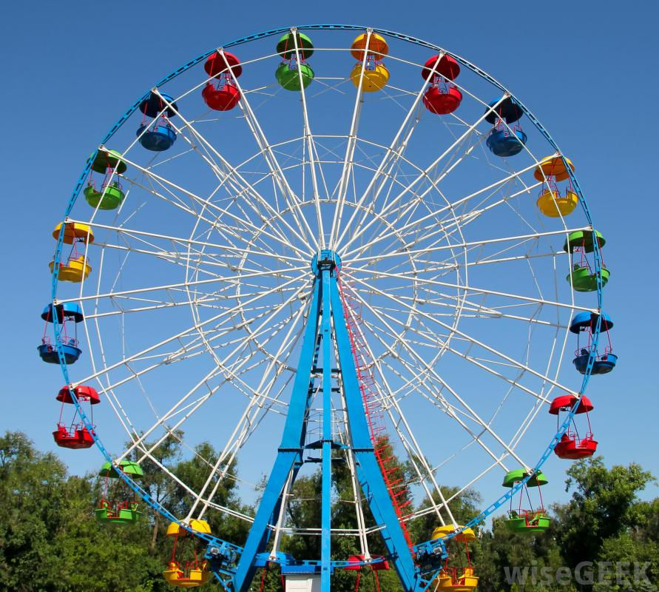
Uniform circular motion
The motion of an object in a circle with a constant or uniform speed.
An object in uniform circular motion will cover the same linear distance in each second of time.

Slide 4
Uniform circular motion
If a car were to move in a circle with a constant speed of 5m/s, then the car would travel 5 meters along the perimeter of the circle in each second.
The distance of one complete cycle around the perimeter of a circle is known as the circumference

Slide 5
Uniform circular motion and average speed
Objects moving around circles of different radius in the same amount of time (period), the object traveling the circle of larger radius must be traveling with the greatest speed.
This means average speed and the radius of the circle are directly proportional.
An example to illustrate this is radar

Slide 6
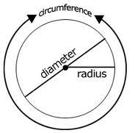
Uniform circular motion and average speed
The relationship between the circumference of a circle, the time to complete one cycle around the circle, and the speed of the object is expresses in this formula:
Average Speed = $\frac{Distance}{Time}$ = $\frac{Circumference}{Time}$
The circumference of any circle can be calculated using the following formula:
Circumference = 2 (π) (Radius)

Slide 7
Uniform circular motion and average speed
Combining these two equations will lead to the following equation relating the speed of an object moving in uniform circular motion to the radius of the circle and the time to make one cycle around the circle.
Average Speed = $\frac{\text{2 (}\text{π) (}\text{Radius}\text{) }}{Time}$
Time of one cycle around the circle:
$$Time=\frac{Time (seconds)}{\# of rotations}$$

Slide 8
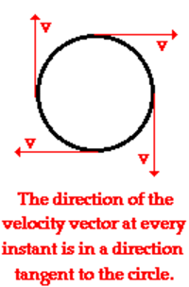
The direction of the velocity vector
An object moving in uniform circular motion will have a constant speed but its velocity vector will be continuously changing.
The direction of the of the velocity vector at any instant is in the direction of a tangent line drawn to the circle at the object’s location.

Slide 9
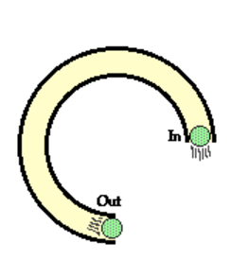
Check for understanding
A tube is been placed upon the table and shaped into a three-quarters circle. A golf ball is pushed into the tube at one end at high speed. The ball rolls through the tube and exits at the opposite end. Describe the path of the golf ball as it exits the tube.

Slide 10
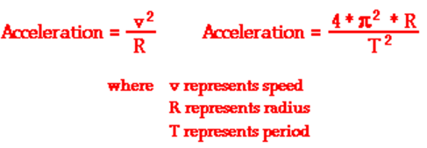
Acceleration
Even if the object has uniform circular motion doesn’t mean it’s not accelerating. It direction constantly changing, which makes it accelerating.
The acceleration of an object moving in a circle can be determined using either of the two formulas below.

Slide 11
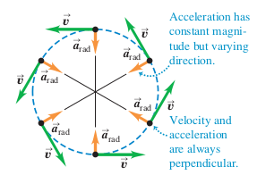
Direction of the Acceleration vector
The acceleration of an object in uniform circular motion will be in the same direction as the velocity change vector, and the acceleration is directed towards the center of the circle as well.

Slide 12
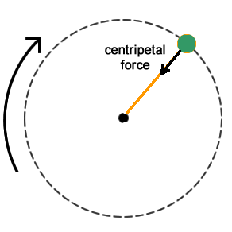
Centripetal Force
Since an object in uniform circular motion experiences an acceleration towards the center of the circle, it is also experiences a net force.
The direction of the net force will be the same direction as the acceleration.
The force that acts inward upon an object moving in a circle is referred to as the centripetal force requirement.

Slide 13
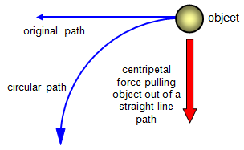
Centripetal Force
Remembering Newton’s 1st Law, objects want to travel in a straight line and continue with motion.
The centripetal force (an unbalanced force) is required for objects to move in circles.

Slide 14
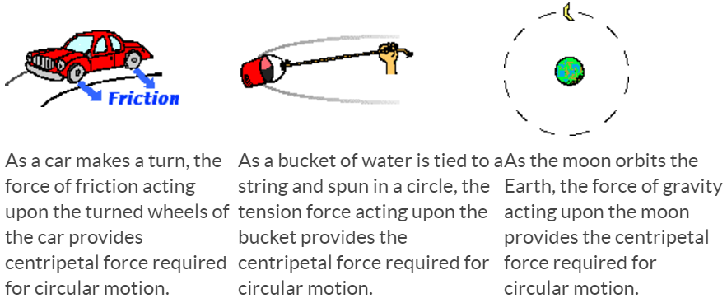
Centripetal Force
Centripetal force alters the direction of an object but not its speed.
It causes it to deviate from its straight-line path and accelerate inwards and move along a circular path.
Centripetal is a term used describe the direction of the force.

Slide 15
Calculating Force
The net force acting on an object moving in a circle can be determined using either of the three formulas below.

Slide 16
$$Average Speed= \frac{\text{2 }\text{ (}π\text{)}\text{( }\text{Radius}\text{) }}{Time}$$
$$Force=mass \left(acceleration\right)$$
$$Force=mass x \frac{{Velocity}^{2}}{Radius}$$
$$Acceleration= \frac{V^{2} }{Radius}$$
$$Force=mass x \frac{\left.{4 (π}^{2})(Radius\right)}{{Time}^{2}}$$
$$Acceleration= \frac{\left.{4 (π}^{2})(Radius\right)}{{Time}^{2}}$$
$$Time= \frac{Time (seconds)}{Number of rotations}$$

Slide 17
Practice
A 900-kg car moving at 10 m/s takes a turn around a circle with a radius of 25.0 m. Determine the acceleration and the net force acting upon the car.
Known Information: Looking for:
M = A =
V = F =
R =

Slide 18
Practice
A 95-kg halfback makes a turn on the football field. The halfback sweeps out a path that is a portion of a circle with a radius of 12-meters. The halfback makes a quarter of a turn around the circle in 2.1 seconds. Determine the speed, acceleration and net force acting upon the halfback.
Known Information: Looking for:
M = V =
R = A =
Traveled ¼ of the circumference in 2.1s F =

Slide 19
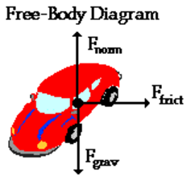
Circular Motion and Newton’s 2nd Law
Newton’s 2nd law and free-body diagrams can help analyze the motion of objects going in circles or along curved paths.
For example, the car going in a circle will have three forces acting on it; the force of gravity, the normal force, and the frictional force.

Slide 20
Circular Motion and Newton’s 2nd Law
The frictional force supplies the centripetal force requirement for the car to move in the circle.
Since the normal and gravitational force cancel each other out, the frictional force is the net force.
Without this friction, the car would turn its wheels but would not move in a circle.

Slide 21
Practice
The maximum speed with which a 945-kg car makes a 180-degree turn is 10 m/s. The radius of the circle through which the car is turning is 25 m. Determine the force of friction and the coefficient of friction acting upon the car.
Refresh on a few equations:
$F_{grav}=mass(gravity)$
$F_{frict}$ = μ ($F_{norm}$)

Slide 22
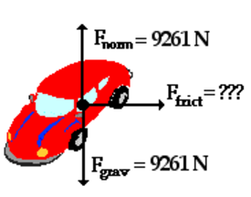
Practice
The maximum speed with which a 945-kg car makes a 180-degree turn is 10 m/s. The radius of the circle through which the car is turning is 25 m. Determine the force of friction and the coefficient of friction acting upon the car.
Known Information: Requested Information
M = $F_{Frict}$ =
V = μ =
R =

Slide 23
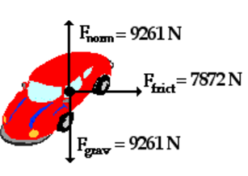
Practice
The coefficient of friction acting upon a 945-kg car is 0.850. The car is making a 180-degree turn around a curve with a radius of 35 m. Determine the maximum speed with which the car can make the turn.
Known Information: Requested Information
M = V =
μ =
R =

Slide 24
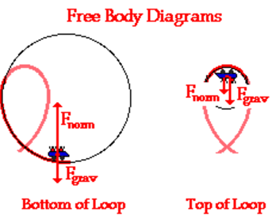
Roller Coaster Physics
A roller coaster car will experience two forces, the force of gravity and the normal force.
The normal force is directed in a direction perpendicular to the track and the gravitational force is always directed downwards.
At the bottom of a loop, the normal force will be up
At the top of a loop, the normal force will be down

Slide 25
Roller Coaster Physics
To calculate the normal force at the bottom of the loop the formula will be:
$F_{norm}$ = $F_{grav}$ + $F_{net}$
To calculate the normal force at the top of the loop the formula will be:
$F_{norm}$ = ${F_{net}−F}_{grav}$

Slide 26
Practice
Anna is riding on a roller coaster at Great America. She experiences a downward acceleration of 15.6 m/s² at the top of the loop and an upward acceleration of 26.3 m/s² at the bottom of the loop. Use Newton's second law to determine the normal force acting upon Anna's 864 kg roller coaster car.
Known Information Requested Information
M = $F_{norm}$ at the top =
$a_{top}$ = $F_{norm}$ at the bottom =
$a_{bottom}$ =

