Slide 1
Unit 9 Vocabulary
Electrostatics
Electrical Force
Charge
Coulomb’s Law
Coulomb
Electrically polarized
Electric field
Voltage
Electric current
Amperes
Electric resistance
Ohm’s Law
Alternating current
Direct current
Circuit
Series circuit
Parallel circuit
Magnetic domains
Electromagnet

Slide 2
Electrostatic

Slide 3
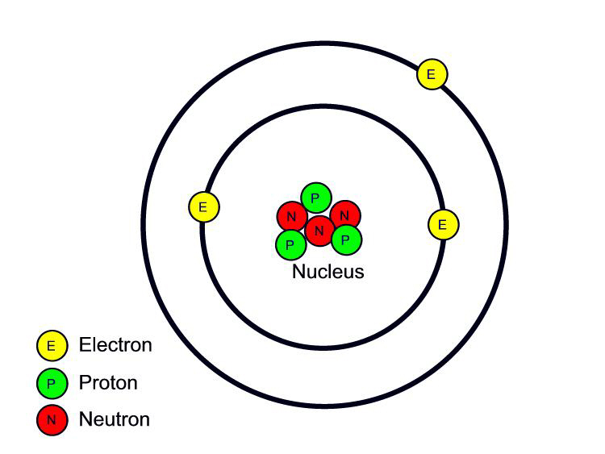
A few things to remember…
An atom has a positively charged nucleus, surrounded by negatively charged electrons.
Electric charge refers to electrons
All e- are identical
Same mass
Same amount of charge (negativity)

Slide 4
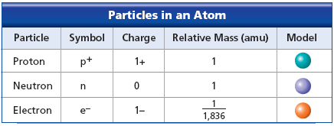
Comparing positive and negative
When comparing protons (p+) and electrons (e-):
The amount of positive charge of a proton EQUALS the amount of negative charge of an electron

Slide 5
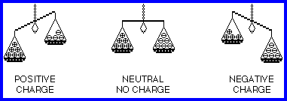
Charge
Most atoms are neutral: p+ = e-
An object with an unequal number of protons and electrons is said to be CHARGED
More electrons means negatively charged
More protons means positively charged.

Slide 6
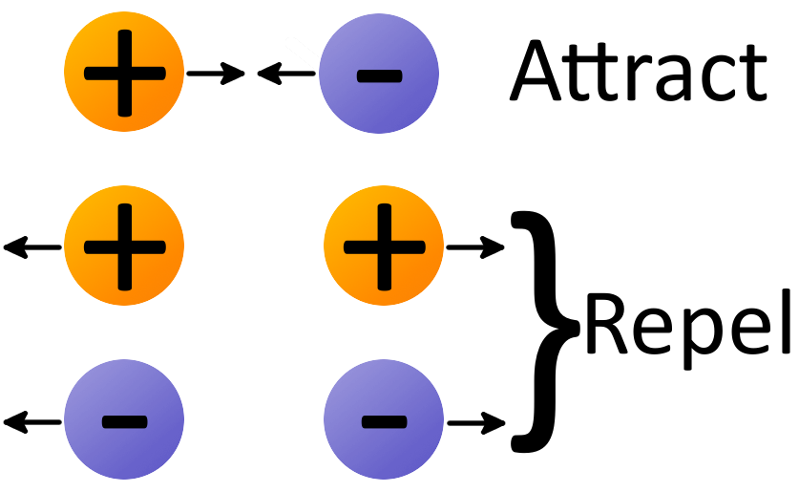
Opposites Attract
Like charges = repel
Opposite charges = attract

Slide 7
Law of conservation of charge
Electrons are neither created nor destroyed, they are transferred from one object to another.

Slide 8
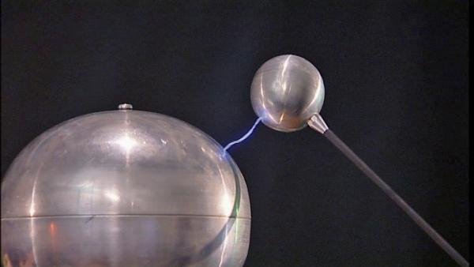
Electrostatics
Electricity at rest
Electric charges are collected and held in place
Static electricity
Lightning

Slide 9
Three ways to transfer electrons from one object to another
Charging by friction
Charging by contact
Charging by induction
https://www.youtube.com/watch?v=tuZxFL9cGkI

Slide 10
Coulomb’s Law

Slide 11
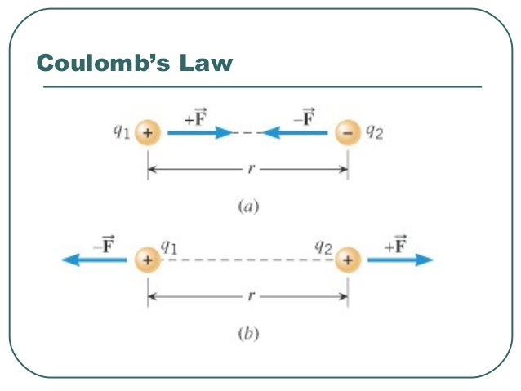
Three things coulomb’s law relate
Charge of object
Distance between them
Force applied between them

Slide 12
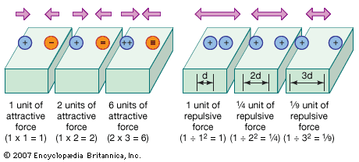
Forces
Force is inversely proportional to the distance between the charges
When one increased, the other decreases
If distance is doubled then the force will decrease by 4
If distance is tripled then the force will decrease by 9

Slide 13
Forces
Force is directly proportional to the size of each charge.
When one increase, the other will increase by the same amount
Double 1 charge, the force will double
Double both charges, the force quadruples

