Slide 1
Energy

Slide 2
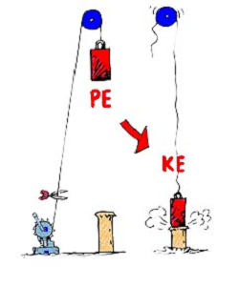

Slide 3
Energy
Enables work to be done
All forms of energy fall under two categories:
Potential Energy
Kinetic Energy

Slide 4
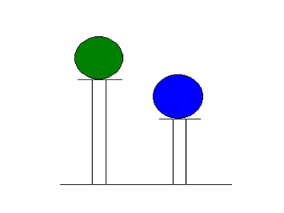
Potential Energy
Stored energy
Compressed spring
Stretched rubber band
Battery
Energy at rest
Energy due to position: Gravitational PE (must be elevated)

Slide 5
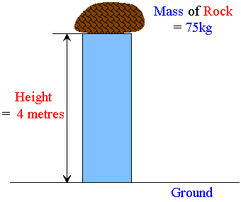
Potential Energy
Depends on three things:
Object's mass
Object's height
Force of gravity
PE= mgh (Mass)(Gravity)(Height)
PE= Wh (Weight)(Height)
Unit = Joules

Slide 6
Try This
How much potential energy would a 15kg boulder have if it were on a hill 35m high?
How much potential energy does a 6N ball have on a 2m step?

Slide 7
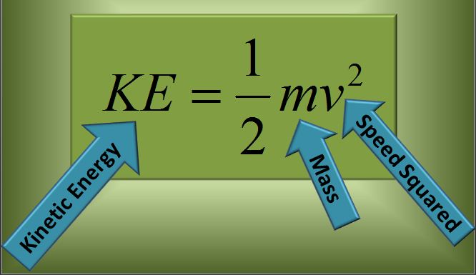
Kinetic Energy (KE)
Energy of motion
Must be moving
Units = Joules

Slide 8
Try This
An object with a mass of 200kg travels at 2m/s. What is the KE?

Slide 9
Kinetic Energy
KE is directly proportional to mass
KE is directly proportional to velocity squared
2x V = 4x KE
3x V = 9x KE
4x V = 16x KE

Slide 10
Kinetic Energy
Calculate the KE of a 1600 Kg car moving 5 m/s
What would happen to the KE if you doubled the speed?

Slide 11
Mechanical Energy
Mechanical energy is energy that is possessed by an object due to its motion or its stored energy of position.
Kinetic energy = energy of motion
Potential Energy = stored energy due to position
An object that possesses mechanical energy is able to do work!

Slide 12
