Slide 1
Projectile Motion
Honors Physics

Slide 2
What is a projectile
A projectile is an object upon which the only force acting is gravity.
An object dropped from rest is a projectile (provided that the influence of air resistance is negligible).
An object that is thrown vertically upward is also a projectile (provided that the influence of air resistance is negligible).
An object which is thrown upward at an angle to the horizontal is also a projectile (provided that the influence of air resistance is negligible).
A projectile is any object that once projected or dropped continues in motion by its own inertia and is influenced only by the downward force of gravity.

Slide 3
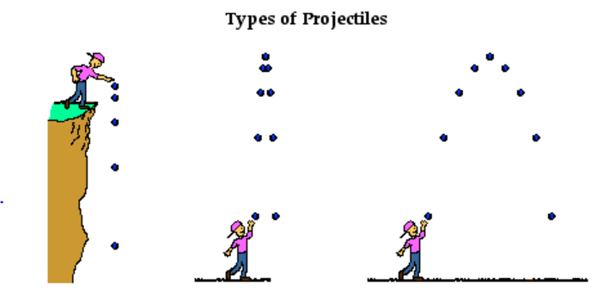
Examples of Projectiles

Slide 4
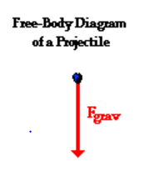
Free-Body Diagram of a Projectile
A projectile has a single force that acts upon it - the force of gravity.
A free-body diagram of a projectile should show a single force acting downwards and labeled force of gravity (or simply F_{grav}).

Slide 5
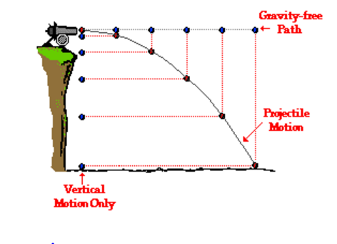
Characteristics of a Horizontal Projectile
There are two components of a projectile's motion - horizontal and vertical motion. These perpendicular components of motion are independent of each other,
The projectile travels with a constant horizontal velocity (inertia) and a downward vertical acceleration. (due to gravity)

Slide 6
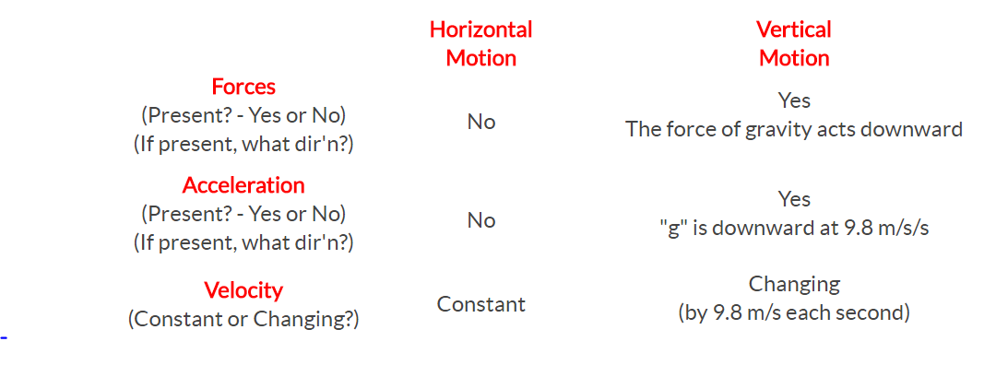
In summary:

Slide 7
Check your understanding

Slide 9
Check your understanding

Slide 10
The answer is B.
The package will land directly below the plane. The horizontal motion of the falling package remains constant, and as such, the package will always be positioned directly below the plane. The force of gravity causes the package to fall but does not affect its horizontal motion

Slide 11
In Summary :
A projectile is any object upon which the only force is gravity,
Projectiles travel with a parabolic trajectory due to the influence of gravity,
There are no horizontal forces acting upon projectiles and thus no horizontal acceleration,
The horizontal velocity of a projectile is constant (a never changing in value),
There is a vertical acceleration caused by gravity; its value is 9.8 m/s/s, down,
The vertical velocity of a projectile changes by 9.8 m/s each second,
The horizontal motion of a projectile is independent of its vertical motion.

Slide 12
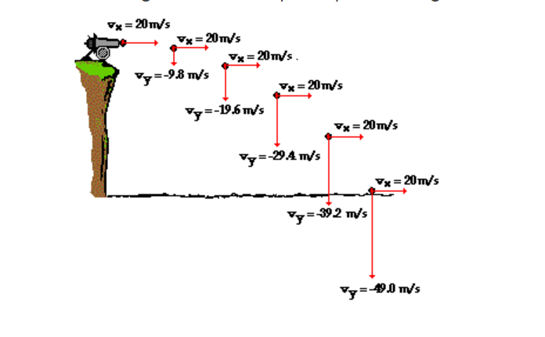
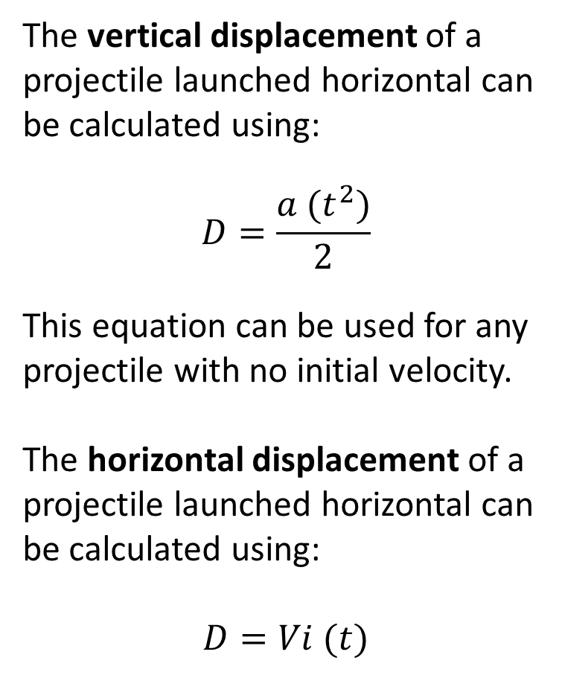
Horizontal Launch
The vertical displacement of a projectile launched horizontal can be calculated using:
$$D=\frac{a (t^{2})}{2}$$
This equation can be used for any projectile with no initial velocity.
The horizontal displacement of a projectile launched horizontal can be calculated using:
$$D=Vi (t)$$

Slide 13
Vector Resolution of Components
Consider a projectile launched with an initial velocity of 50 m/s at an angle of 60 degrees above the horizontal.
Using trig functions, determine the horizontal and vertical components.

Slide 14
Vector Resolution of Components
When resolving the component of a projectile launched at an angle, you are calculating the initial velocity of the horizontal and vertical components.
You can then used these to calculate the horizontal displacement, the vertical displacement, the final vertical velocity, the time to reach the peak of trajectory, and the time to fall to the ground.

Slide 15
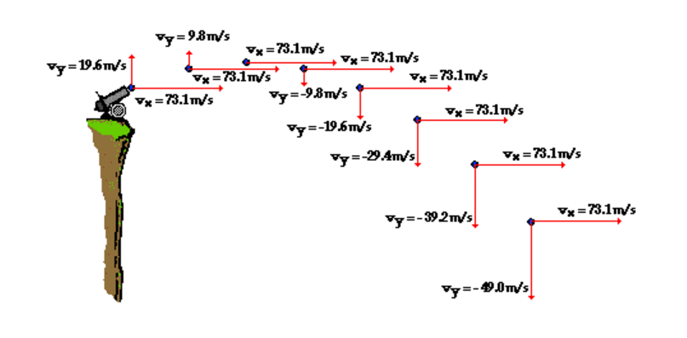
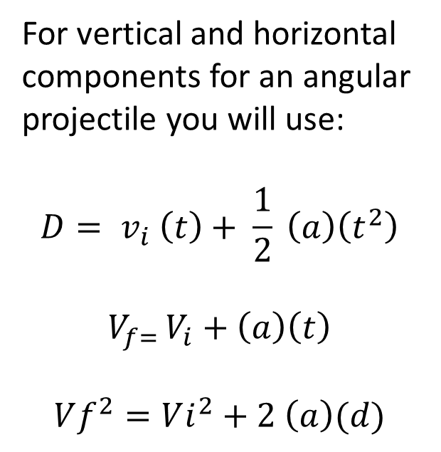
Angular Launch
For vertical and horizontal components for an angular projectile you will use:
$$D= v_{i} \left(t\right)+ \frac{1}{2} \left(a\right)\left(t^{2}\right)$$
$$V_{f= }V_{i}+\left(a\right)\left(t\right)$$
$$Vf^{2}=Vi^{2}+2 \left(a\right)(d)$$
**Of these three equations, the top one is used the most when calculating horizontal variables.

Slide 16
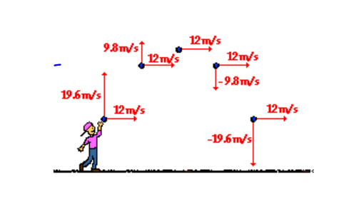
Symmetrical Nature
The vertical speed two seconds before reaching its peak is the same as the vertical speed two seconds after falling from its peak. For non-horizontally launched projectiles, the direction of the velocity vector is sometimes considered + on the way up and - on the way down

Slide 17
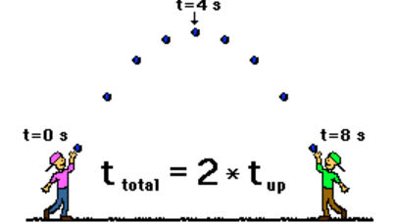
Determining the Time in Flight
Once the time to rise to the peak of the trajectory is known, the total time of flight can be determined. For a projectile that lands at the same height which it started, the total time of flight is twice the time to rise to the peak.
The time for a projectile to rise to its peak is a matter of dividing the vertical component of the initial velocity (v_{i}) by the acceleration of gravity (a).
$T_{up}=\frac{V_{i}}{a}$

Slide 18
Determining Peak Height
To determine the peak height, use the time up (half of the full time) in the formula:
$$D= v_{i} \left(t\right)+ \frac{1}{2} \left(a\right)\left(t^{2}\right)$$

Slide 19
Angular Launch
A football is kicked with an initial velocity of 20 m/s at an angle of 45 degrees with the horizontal. Determine the time of flight, the horizontal displacement, and the peak height of the football.
Horizontal information
D =
$V^{i}$=
$V^{f}$=
A =
T=
Vertical information
Peak =
$V^{i}$=
$V^{f}$=
A =
T=

