Slide 1
Kepler’s Three Laws
Honors Physics

Slide 2
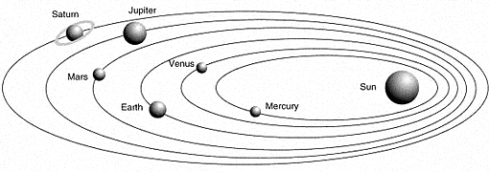
Kepler’s Three Laws
In the early 1600s Johannes Kepler proposed three laws of planetary motion.
The three laws help describe the motion of any planet and any satellite.

Slide 3
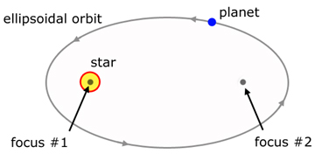
Kepler’s 1st Law: The Law of Ellipses
The path of the planets about the sun is elliptical shape, with the center of the sun being located at one focus.
Explains that planets are orbiting the sun in a path described as an ellipse.
An ellipse is a special curve in which the sum of the distances from every point on the curve to two other points is a constant. The two other points are known as the foci of the ellipse.

Slide 4
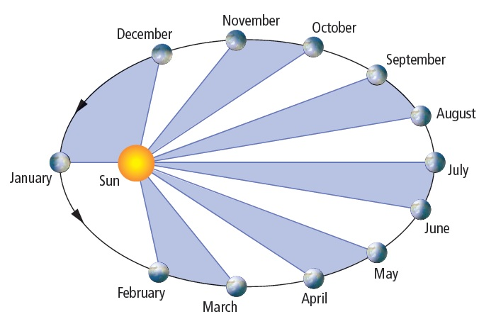
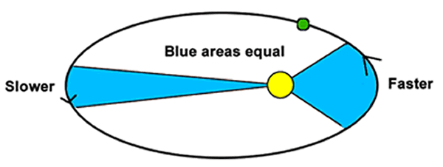
Kepler’s 2nd Law: The Law of Equal Mass
An imaginary line drawn from the center of the sun to the center of the planet will sweep out equal areas in equal intervals of time.
It describes the speed at which any given planet will move while orbiting the sun.
A planet moves fastest when it its closest to the sun and slowest when it is further away.

Slide 5
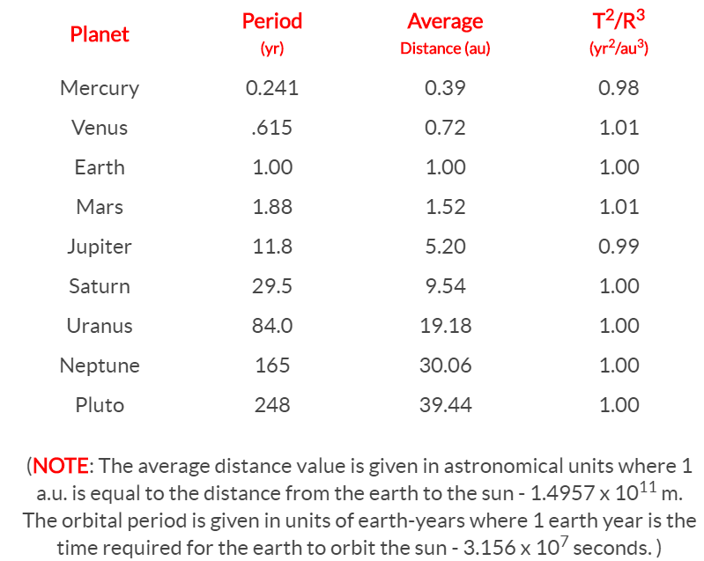
Kepler’s 3rd Law: The Law of Harmonies
The ratio of the squares of the periods of any two planets is equal to the ratios of the cubes of their average distances from the sun.
Compares the orbital period and radius of orbit of a planet to those of other planets.
The comparison is that the ratio of the periods squared and radius cube is the same for every planet.

