Slide 1
Law of Conservation of Momentum

Slide 2
Discuss with a partner: What does it mean to conserve something?
To save
To only use a portion of
To make it last
To store
Discuss with a partner: what is conservation of momentum?
The momentum of a system remains the same if there are no external forces
We can illustrate this concept using collisions between objects
The momentum of the objects before the collision is equal to the momentum of the objects after the collision
MV_{total} = Mv_{total}
M1V1 + M2V2 = M1V1 + M2V2 (elastic collision)
M1V1 + M2V2 = MV (inelastic collisions)

Slide 3
Elastic Collisions
Elastic collisions occur when two or more objects collide without being deformed or creating heat
The objects bounce off of each other and transfer their momentum
Before Collision after
2 m/s
0 m/s
0 m/s
2 m/s
2 m/s
2 m/s
2 m/s
2 m/s
2 m/s
1 m/s
1 m/s
2 m/s

Slide 4
Inelastic Collisions
Inelastic collisions occur when colliding objects become tangled, coupled or combined
Ex:
30,000 kg
30,000 kg
0 m/s
V = ??
8 m/s

Slide 5
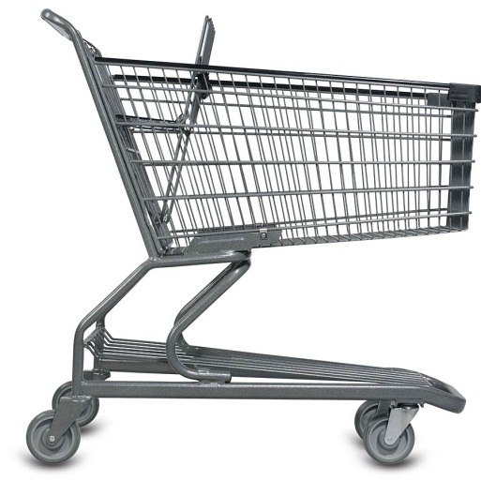
75 kg
2 m/s
15 kg
2 m/s
V = ??

Slide 6
A .3 kg marble rolls to the right at 20 m/s and hits has a head-on collision with a .6 kg marble moving 15 m/s to the left. After the collision, the first marble moves to the left at 15 m/s. What is the second marbles final velocity? (Any object moving to the left will be represented as a negative velocity)

Slide 7
A 2 kg goldfish is swimming towards the right at 5 m/s when a 15 kg puffer fish swims up and eats it. The pufferfish was swimming towards the left at 7 m/s. What is the final velocity of the two fish after the puffer fish eats the goldfish?

Slide 8
A quick review video on conversation of momentum

Slide 9
https://www.youtube.com/watch?v=r8E5dUnLmh4 (Mythbusters)
Think how you could use the conservation of momentum formula to prove why and how the cars look they way they do after the crash.

