Slide 1
Magnets
physics

Slide 2
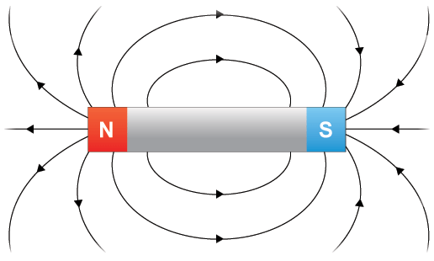
Magnets
The ends of a magnet are called poles
Like poles repel (+ and +) or (- and -)
Unlike poles attract (+ and -)
The space around a magnet where the magnetic force is exerted is called the magnetic field.

Slide 3
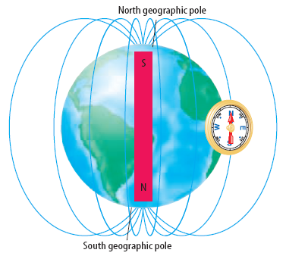
The earth is like a giant magnet!
The nickel iron core of the earth gives the earth a magnetic field.
The geographic north and magnetic north are on opposite sides of the Earth.
A compass needle is a magnet. It is attracted to the southern magnetic pole of the Earth which is found at geographic north.

Slide 4
Why Earth’s Magnetic shield matters!
https://www.youtube.com/watch?v=XXFVpwecixY&t=1s

Slide 5
Which of the following are magnetic?
Paper clip
Aluminum foil
nail
paper
quarter
Penny
Razor blade
Sewing needle
Wood
Nickel

Slide 6
Ferromagnetic Elements
These are strongly attracted to magnets
Most common ferromagnetic elements are iron, cobalt and nickel.
The word ferromagnetic has its root from the element iron.

Slide 7
Magnetic Domains
Groups of atoms join so that their magnetic fields are all going in the same direction
These areas of atoms are called “domains”
When an unmagnetized object is placed in a magnetic field, the object can become magnetized when the domains line up in the same direction.

Slide 8
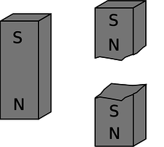
Magnet Properties
Hard ferromagnetic materials make better permanent magnets because their domains are not easily moved.
A strong magnet can actually attract both poles of a weak magnet because it forces the domains of the weak magnet to realign at both ends
If you break a magnet in two, it makes two magnets and the two ends will be attracted to each other.

Slide 9
Magnetic Putty
https://www.youtube.com/watch?v=MfNt44pFo9o

Slide 10
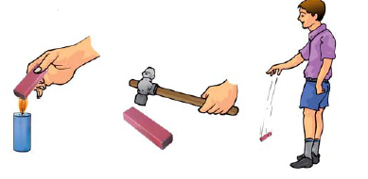
Loss of Magnetism
Dropping a permanent magnet weakens it because the domains get mixed up and out of alignment.
Heating up a magnet weakens it because it increases the random motion of the atoms which changes the alignment of the domains.

