Slide 1
Newton’s Law of Universal Gravitation

Slide 2
Gravitation
Every object with mass attracts every other object with mass.
Newton realized that the force of attraction between two massive objects:
Increase as the mass of the objects increases.
Decreases as the distance between the objects increase.

Slide 3
Law of Universal Gravitation
$F_{G}=G \frac{M_{1}M_{2}}{r^{2}}$
G = Gravitational Constant
G = 6.67x10⁻¹¹ N*m²/kg²
M₁ and M₂ = the mass of two bodies
r = the distance between them

Slide 4
Practice
Two students are sitting 1.5 m apart. One student has a mass of 70 kg and the other has a mass of 52 kg. What is the gravitational force between them?

Slide 5
Practice
What gravitational force does the moon produce on the Earth as their centers are 3.88 X 10⁸ m apart and the moon has a mass of 7.34 X 10²² kg? (The mass of the Earth is 5.9 X 10²⁴ kg)

Slide 6
Finding mass of Objects with equal mass
$M= \sqrt{\frac{F_{g}(D^{2})}{G}}$
G = Gravitational Constant
G = 6.67x10⁻¹¹ N*m²/kg²
M = the mass of two bodies
r = the distance between them
$F_{g}$ = Force of gravity

Slide 7
Practice
If the gravitational force between objects of equal mass is 2.33 X 10⁸ N when the objects are 10 m apart. What is the mass of each object?

Slide 8
Finding the mass of one object
$M_{1}= \frac{F_{g}(D^{2})}{G(M_{2})}$
G = Gravitational Constant
G = 6.67x10⁻¹¹ N*m²/kg²
M = the mass of two bodies
r = the distance between them
$F_{g}$ = Force of gravity

Slide 9
Practice
The gravitational force between two objects that are 2.1 x 10⁻¹ m apart is 3.2 X 10⁻⁶ N. If the mass of one object is 55 kg, what is the mass of the other object?

Slide 10
Finding the distance between objects
$r= \sqrt{\frac{G (M_{1 }x{ M}_{2 })}{F_{g}}}$
G = Gravitational Constant
G = 6.67x10⁻¹¹ N*m²/kg²
M = the mass of two bodies
r = the distance between them
$F_{g}$ = Force of gravity

Slide 11
Practice
If two objects, each with a mass of 2 X 10² kg, produces a gravitational force between them is 3.5 X 10⁻⁶ N. What is the distance between them?

Slide 12
Law of Universal Gravitation
It is an inverse-square law:
If the distance doubles, the force drops to ¼
If the distance triples, the force drops to 1/9
Distance X 10 = $\frac{F_{G}}{100}$

Slide 13
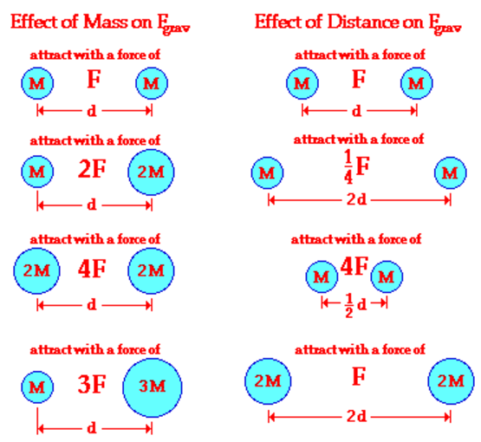

Slide 15
Some things Newton didn’t know
Newton didn’t know that gravity bends light.
He also didn’t know that gravity slows down time.
Clocks near the surface of the Earth run slightly slower than clocks higher up.

Slide 16
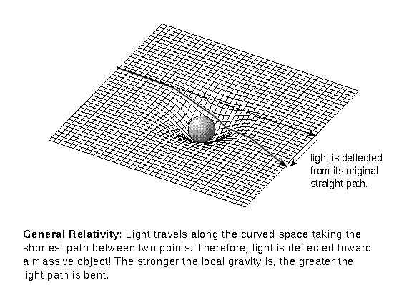
Curvature of Space-time

Slide 17
Gravity
According to Einstein, gravity isn’t technically a force.
It’s an effect caused by the curvature of space-time by massive bodies.
Why we treat it as a force?
In normal situations, Newton’s Law of Universal Gravity provides an excellent approximate of the behavior of massive bodies.

