Slide 1
Electric Fields and Potential

Slide 2
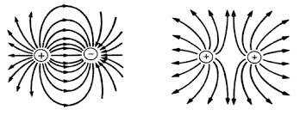
Electric Fields
Every electric charge is surrounded by an electric field, where electric forces can be experienced

Slide 3
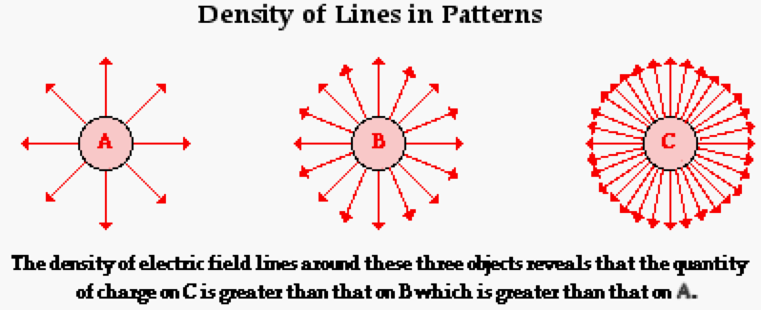
Electric Fields
A strong electric force = a large electric field

Slide 4
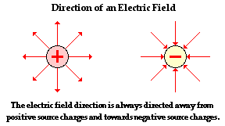
Electric Fields
The direction of an electrical field around a proton is away from the proton.
The direction of an electrical field around an electron is towards the electron.

Slide 5
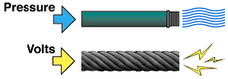
Electric Potential Energy
Electric potential is how much electrical potential energy an object has per charge
Measured in volts (also known as voltage)
Voltage is what causes current

Slide 6
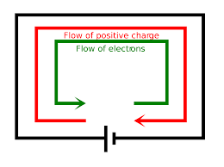
Electric Current
The flow of charges in a current will continue until each end reaches a common potential (there is no more difference between the two ends so no need for the charge to move)

Slide 7
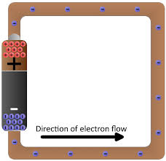
1 amp = flow of 1 coulomb of charge per sec 1 coulomb = 6.24 billion billion electrons That’s 624,000,000,000,000,000, elections per second!
Electric Current
The flow of electric charges is known as electric current
Current is measured in Amps
The direction of the electron flow is always from the negative to the positive.

Slide 8
Electric Current
To keep current flowing, there must be a constant potential difference in the conductor.
This is created using a voltage source
Cells (batteries)
Convert chemical energy into electrical energy
Generators
Convert mechanical energy into electric energy
The voltage source provides “electric pressure” to move electrons through the conductor

Slide 9
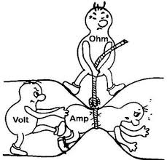
Resistance to Current
The amount of current running through a conductor depends on the voltage as well as how much resistance there is
Resistance keeps charges from moving
Resistance is measures in Ohms and represented by the Greek letter omega (ῼ)

Slide 10
Resistance
Resistance depends on 4 things
Wire conductivity
The more conductive it is, the less resistance
Wire length
The shorter the wire, the less resistance
Wire thickness (diameter)
The thicker the wire, the less resistance
Wire temperature
The cooler the wire, the less resistance

Slide 11
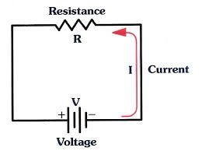
Electric Circuit

Slide 12
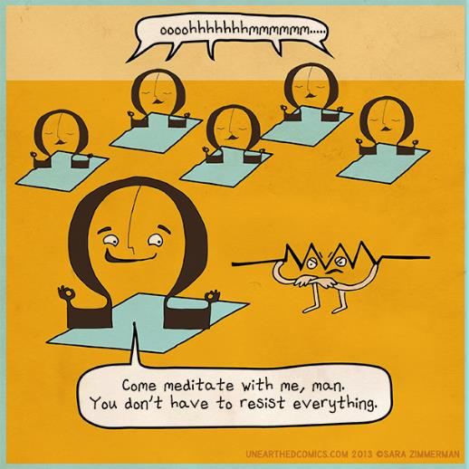
Resistance

Slide 13
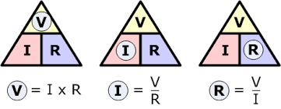
Ohm’s Law
Current is directly proportional to voltage and inversely proportional to resistance
As voltage increases, so does current
As resistance increases, current decreases
Current = voltage Amps = volts I = V resistance ohms ῼ

