Slide 1
Warm-up
Create a mnemonic device to help you remember the order of the electromagnetic spectrum.
(Mnemonic devices are techniques a person can use to help them improve their ability to remember something. In other words, it's a memory technique to help your brain better encode and recall important information.)

Slide 2
Raging Martians Invaded Venus Using X-ray Guns
Radio, Microwaves, Infrared, Visible light, Ultraviolet, X-rays, Gamma rays

Slide 3
Wave Behavior

Slide 4
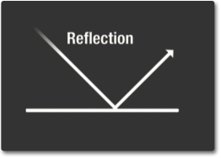
Reflection
When a wave hits an object and bounced off the object.

Slide 5
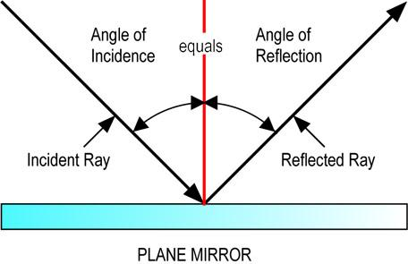
The Law of Reflection
The angle of incidence equals the angle of reflection.
When a wave is reflected, the reflected waves occurs at the same angle as the source wave.

Slide 6
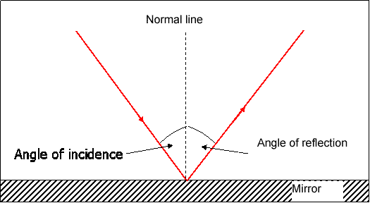
The Normal Line
An imaginary line that is perpendicular (at a 90 degree angle) to the reflective surface.
Where the light strikes the surface.

Slide 7
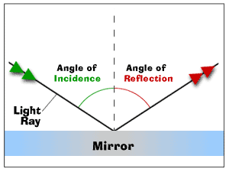
The Angle of Incidence
The angle between the incident ray and the normal.

Slide 8
The angle of reflection
The angle between the reflected ray and the normal

Slide 9
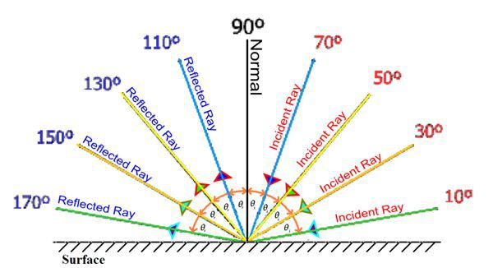
Diagram of the Law of Reflection
As the angle of incidence changes, so does the angle of reflection.

Slide 10
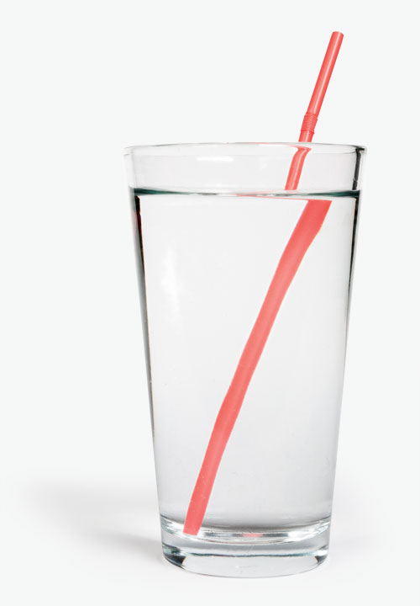
Refraction
The bending of a wave as it moves from one medium to another.
Occurs because the wave speed changes.
Example: a straw in a glass will appear broken because of refraction.

Slide 11
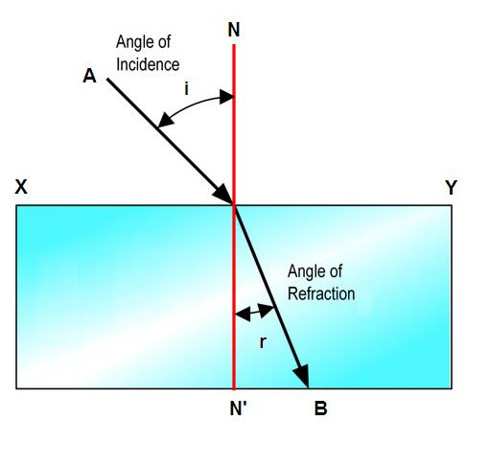
Light entering water
When a wave enters a medium that is MORE dense, it will bend TOWARDS the normal because it slows down.

Slide 12
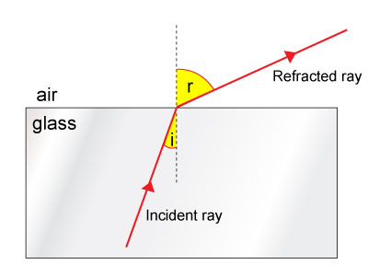
Light leaving the water
When a wave enters a medium that is LESS dense, it will bend AWAY from the normal because it speeds up

Slide 13
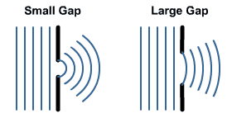
Diffraction
The bending of waves around boundaries or through openings.
When an object causes a wave to bend
Why we can see light from the sun during an eclipse.
Why you can hear sound around a corner.

Slide 14
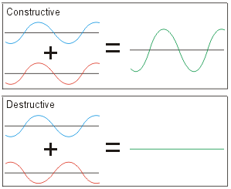
Interference
Occurs when waves overlap and combine together.
2 Kinds:
Constructive:
When the crests of both waves overlap
Causes a bigger wave
Brighter light or louder sounds.
Destructive:
When the crests of one overlaps the trough of the other.
Causes smaller wave
Dimmer light or softer sounds

Slide 15
Wave and Light Vocabulary
Law of Reflection
Angle of reflection
Normal
Angle of incidence
Refraction
Constructive interference
Destructive interference
Reflection
Photons
Ultraviolet
Gamma rays
Speed of light
Microwaves
White light
Visible light

