Slide 1
Work and power

Slide 2
Work
In science, WORK is defined as force times distance
To do work on an object the following must occur:
A force is applied
The force is constant
The object MUST MOVE in the DIRECTION of the FORCE being applied

Slide 3
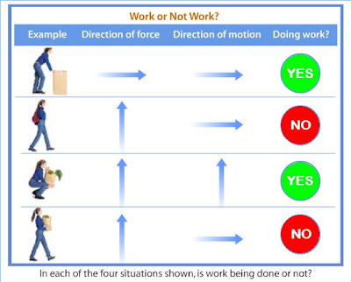
Work or no work?

Slide 4
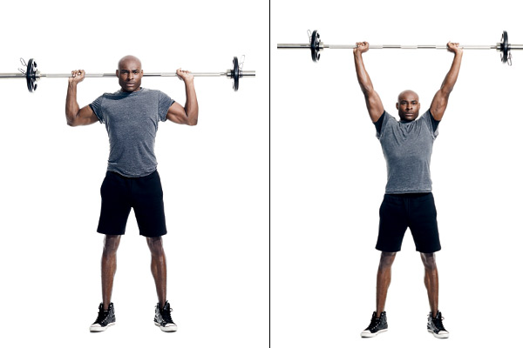
Work Example
A FORCE is applied to the barbell and the barbell moves in the direction of the force
What if she holds it over her head for 3 hours. Is that work?

Slide 5
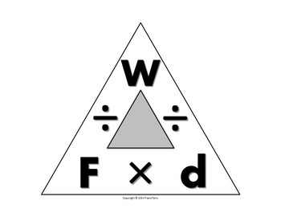
Work FORMULA
Work = Force X Distance
Unit = Joule
Work is directly proportional to force
If you double the force you double the amount of work
Work is directly proportional to distance
If you double the distance you double the amount of work

Slide 6
Work
When lifting a barbell, how much more work is done lifting a twice as heavy barbell that same distance?
Twice as much work because if you double the force then you double the work

Slide 7
Check for understanding
If you lift a 150 N object 3 meters, how much work is done?
W = FD
W = (150N)(3m)
W= 450 J

Slide 8
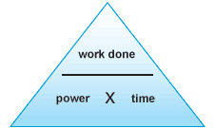
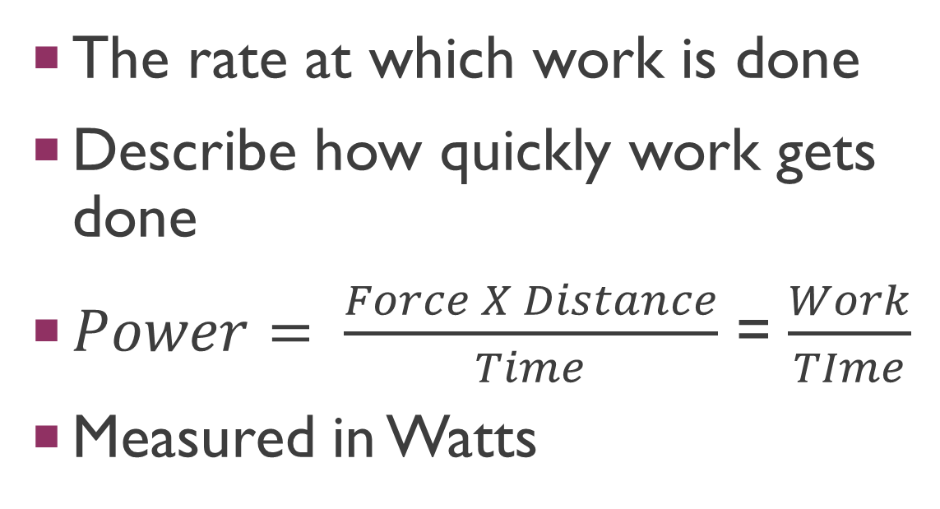
Power
The rate at which work is done
Describe how quickly work gets done
$Power= \frac{Force X Distance}{Time}$ = $\frac{Work}{TIme}$
Measured in Watts

Slide 9
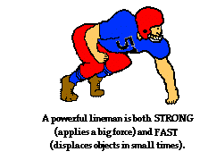
Power
Power is directly proportional to work
If you do twice the amount of work, you will get twice the amount of power
Power is inversely proportional to time
If you take twice as long, you will get half the amount of power.

Slide 10
Check for understanding
A 200N object is moved 10m in 10 seconds, how much power was needed?
P = W/T
W = FD: W=(200N)(10m)
P=(2000J)/(10sec)
P=200W

Slide 11
Video
https://www.youtube.com/watch?time_continue=3&v=pDK2p1QbPKQ

